Slide 1

Fellowship of the Heart
Getting Started — the Four Connects, walked around the table on alternating evenings
Evening Series 2026–27 · at the Tittle home · v1.5E DRAFT
All Scripture: ESV · The Companion lesson plans carry the full scripts — these slides carry the room
1
Notes:
DECK TITLE · pre-session · DIVIDER
On screen as the room assembles on night one. All Scripture ESV; the plans carry the scripts; these slides carry the room — and these notes carry you.

Slide 2

SESSION 15
The Rhythm and the Four Questions
The long walk installed before the sending — and four questions a parent dares to ask at their own kitchen table
Quarter 3: Mission & Rhythm
185
Notes:
S15 · pre-session · DIVIDER
On screen through dinner and as the circle forms. Greet at the door — the slide holds the room.

Slide 3
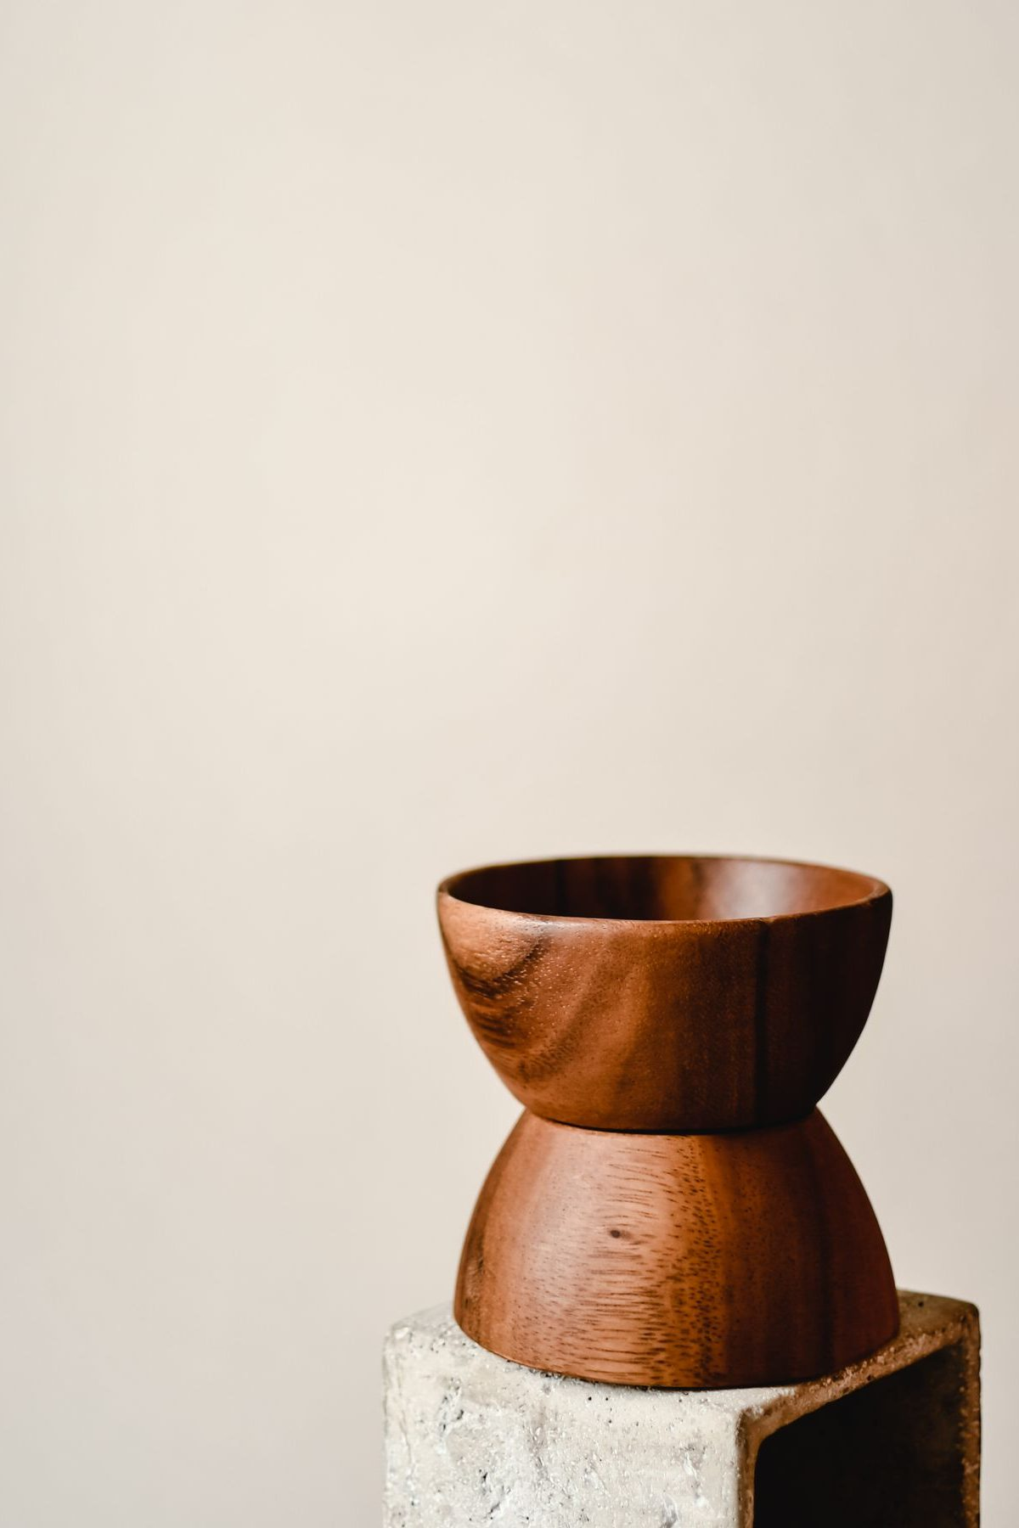
Session 15 — Tonight’s Road
1 Welcome and centering
2 Week 13 completion
3 The long walk — Gal. 6:9
4 The Rhythm Card introduced
5 Building your Rhythm Card
6 The Four Questions
7 The Leader Feedback Round — both leaders
8 Between-week practice — the Rhythm Card begins; the Four Questions go home
9 Closing container + Aaronic blessing
186
Notes:
S15 · 7:00–7:08 · LEAD: CONTAINER HOLDER · TEEN-LED (CiF)
BEATS: 1. The Companion-in-Formation carries today's rhythm arc — their fourth and final lead before Week 22; the Four Questions block belongs to the Lead Companion by design. 2. Frame the night: fourteen weeks of practices stop being something we come to and become something we carry — build your own rhythm in your own handwriting; then the parents receive the bravest homework of the series. 3. Name the gap warmly: the break is coming; momentum does not survive gaps — a rhythm does.
CUES: The Lead Companion sits where the senior can find their eyes all night.

Slide 4
Opening Container — the Eight Steps
1 Welcome — five minutes to open the container
2 Phones silenced and put away
3 Stand in a circle
4 One-word check-in — how you actually are, right now
5 Put out / bring in — set something down; bring a blessing in
6 Spoken commitment: “I am here. I am paying attention. I am willing to be moved.”
7 Opening prayer — “Holy Spirit, you are welcome here. Speak. We are listening.”
8 Sit. Begin.
187
Notes:
S15 · 7:00–7:08 · LEAD: CONTAINER HOLDER · TEEN-LED (CiF, from memory)
BEATS: 1. The senior opens from memory: blessing first, then the container — Safe, Present, Clear, Intentional, same as every week. 2. Two things today: your rhythm, your handwriting; then four questions for the parents. 3. Unhurried — this is their ninth or tenth container rep, and Week 22 will ask for it in public.
CUES: Lead Companion in the senior's eyeline. Anything heavy is the adults' to hold — the senior never carries it.

Slide 5
Week 13 Completion — Finishing the Mission Week
• “Before we walk forward, we finish the Mission week” — unfinished downhill answers finish here
• Two weeks of living with the question usually deepens it — one sentence, now, to the room
• A parent opens the round; teens choose their own depth after — pass-anytime holds
• The answers carry forward to the Week 21 commissioning
• Practice check: one small action aligned with your downhill mission — ninety seconds, one sentence on what happened
188
Notes:
S15 · 7:25–7:29 · LEAD: CONTENT PRESENTER (Lead Companion)
BEATS: 1. Finish the Mission week: anyone whose downhill answer was unfinished, or has changed shape since — one sentence, now, to the room. 2. Receive each without commentary; the answers carry forward to the Week 21 commissioning. 3. Then the practice check, ninety seconds: one sentence on the one small action.
CUES: The arranged parent starts the round (Run Card) — never a cold call on a teen; teens choose their depth; pass anytime.

Slide 6
The Long Walk — Galatians 6:9
• The condition is not “if we feel it.” It is “if we do not give up” — Paul assumes the weariness
• The reaping is tied to the season, and the season is God's — our part is the not-giving-up
• Nobody white-knuckles their way through years; people with a rhythm walk through years
• The break is coming — what carries the practices across a gap is not momentum; it is a rhythm you built on purpose
• So we build it tonight, before the gap, not after it
GALATIANS 6:9 (ESV)
“And let us not grow weary of doing good, for in due season we will reap, if we do not give up.”
189
Notes:
S15 · 7:29–7:36 · LEAD: CONTENT PRESENTER · TEEN-LED (CiF)
BEATS: 1. Read Galatians 6:9 slowly. 2. Teach it: Paul assumes the weariness; the condition is not giving up; the season is His — the not-giving-up is ours. Nobody white-knuckles through years; people with a rhythm walk through years. 3. Name the break plainly: for twelve weeks the room carried the practices; over the break there is no evenings. What crosses a gap is not momentum — it is a rhythm built on purpose, today, before the gap.
GUARD: For some families the breaks ARE the dry season — name that warmly from the front; leadsanions watch who flinches when it is named.

Slide 7
The Rhythm Card Introduced
• The whole series folded into one page — you have already received every practice on this card
• Daily — the morning question, the evening journal note, PROAPT if the season allows
• Weekly — one specific person who knows what you are working on, and a sabbath rhythm
• Monthly — a clearing time and a Four-Connects review. Seasonally — the deeper work
• One rule for the build: “write the rhythm you will actually keep, not the one that impresses you”
• The starter plan begins with two practices totaling six minutes a day — six honest minutes is a real rhythm
190
Notes:
S15 · 7:36–7:39 · LEAD: CONTENT PRESENTER · TEEN-LED (CiF)
BEATS: 1. Rhythm Cards out of the folders: Daily (morning question, evening note, PROAPT if the season allows), Weekly (one named person, a sabbath rhythm), Monthly (clearing time, Four-Connects review), Seasonally. Nothing new — you are choosing what you actually take with you. 2. State the honesty rule; it is the whole exercise: write the rhythm you will actually keep, not the one that impresses you. 3. The starter floor is two practices, six minutes a day — six honest minutes is a real rhythm. 4. After the founder's morning-flow moment (next slide), send the pairs: families together, own handwriting. Go.

Slide 8




A Rhythm You Can See — One Morning Flow
GROUNDED
LISTENING
CHANGED, RIPPLING
LEAPING
The founder’s own morning flow — four images, one motto, kept for years. Yours will look different. The journal has a page waiting for it.
191
Notes:
S15 · 7:36–7:39 · LEAD: CONTENT PRESENTER (90 seconds inside the card intro)
BEATS: 1. Show where a kept card can go — four images, prayed in the same order every morning for years. 2. Walk them: a bench above an evening valley — drawn into God, grounded; a quiet chair with an open Bible — listening for His voice today; rings widening on still water — being changed, ripples reaching people never traced; a hiker mid-leap rock to rock — into the day, certain at each point. Grounding. Hearing. Changing. Leaping. 3. The invitation — never an assignment: as you keep your card, watch for your own four images; the journal has a page waiting.
SUB: These are John's images and John's morning flow, kept for years — present them AS his: this is our founder's rhythm; nobody assigned him these pictures — they became his by keeping them. Do not claim it as yours. Then the invitation stands unchanged.

Slide 9
Building Your Rhythm Card
• Twenty minutes in pairs — in your own handwriting, on the build sheet
• Specific beats vague — “morning question, 6:50, kitchen table, before my phone” is a rhythm
• The weekly partner line is the most important line on the sheet — name an actual person
• Build down, not up — which two practices survive exam season? Start there; the card lets you add later
• Close: each participant reads their daily line aloud to the pair — a parent first; pass-anytime holds
192
Notes:
S15 · 7:39–7:58 · LEAD: CONTENT PRESENTER · FAMILY PAIRS
BEATS: 1. Everyone builds H15.2 in their own handwriting — never typed, never filled in for anyone; families build side by side. 2. Coach specificity: 'morning question, 6:50, kitchen table, before my phone' is a rhythm; a wish is not. 3. Coach DOWN, not up: which two survive exam season? Start there — the card lets you add later. 4. The weekly-partner line is the most important line on the sheet: an actual name. 5. Close with each person reading their daily line aloud to the pair.
CUES: A parent reads first — arranged ahead (Run Card), never a cold call on a teen; pass anytime.
GUARD: A blank weekly line usually means 'nobody would want the job' — don't fix it in the pair; note it for follow-up. Anything heavy goes to the adult after the pair closes.

Slide 10
The Four Questions
• Parents, this next part is for you — nobody answers tonight. This week, at home, for the willing: unhurried, no audience, phone away, yours first
1 What has it been like to live with me all these years?
2 What have been my messages to you?
3 How have I wounded you?
4 What would you like from me going forward?
• The guards — willing only, both directions; receive without defending (listening questions and “thank you” only); invisible by default; a letter counts; the Section 6 boundary
PSALM 139:23–24
Asked of God, it is worship. Asked of your family, it is the bravest form of the same prayer.
James 1:19 — quick to hear, slow to speak.
193
Notes:
S15 · 7:58–8:20 · LEAD: CONTENT PRESENTER · LEAD COMPANION (senior sits as a member)
BEATS: 1. Four questions on the board, in order, aloud — H15.3 has them exact. 2. Name the rehearsal: the weekly feedback round trained this posture. 3. The story (SUB). 4. Commission the willing; the card home in a parent's hand.
GUARD: Willing-only BOTH directions — pass is a full answer at home; alarm on a teen's face = repeat the guard 1:1 before they leave. Receive without defending; never punish an answer later; not ready means wait. Invisible by default — no audits. A letter counts; 'not yet' counts. Abuse or self-harm = Section 6. If it lands on someone mid-block, the second adult moves to them; keep presenting.
SUB: The block ends in the founder's own story of asking these at home. Summarize that John has done this himself — he never once regretted asking — or tell your own if you truly have one. Never claim his.

Slide 11
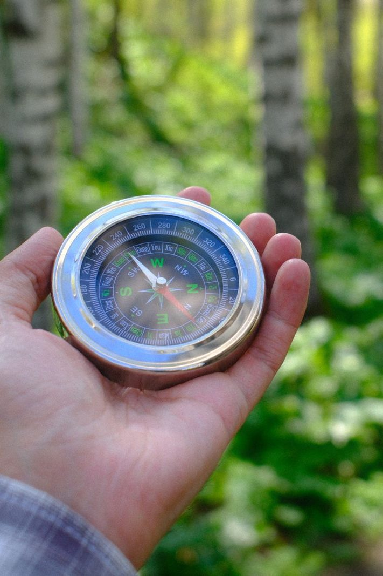
The Leader Feedback Round
• Two rounds, same as every session — the container holder first, then the content presenter: three things each
– “What I think went well tonight: ______”
– “What I’d do differently next time: ______”
– “If I were to teach tonight’s process to someone, I would tell them: ______”
• Then the room — the same two questions about tonight
• The leaders receive without defending — “thank you” is the whole response
194
Notes:
S15 · 8:24–8:28 · LEAD: BOTH LEADERS
BEATS: 1. The senior answers first — went well, do differently, what I'd tell someone teaching this. 2. The Lead Companion answers the two questions for the parts they carried. 3. The room, same two questions — two or three voices each. 4. Close by naming one thing the team watched grow across all four of the senior's leads — and say aloud that the room just heard what this round has been rehearsing all along. It sets the table for Week 22.
GUARD: Receive without defending — 'thank you' is the whole response.

Slide 12
Closing the Container + Aaronic Blessing
• We close the way we opened — the container, six steps:
1 Stand again — same circle, same posture as the open
2 One-word landing — compare it to your opening word
3 The one thing you are taking from tonight
4 The one practice — committed aloud, or modified to one you will actually keep
5 Blessings — specific, witnessed, short
6 Closing prayer — and the Aaronic blessing, spoken over each other, face to face
THE AARONIC BLESSING — NUMBERS 6:24–26
“The Lord bless you and keep you;
the Lord make his face to shine upon you, and be gracious to you;
the Lord lift up his countenance upon you, and give you peace.”
195
Notes:
S15 · 8:28–8:30 · LEAD: CONTAINER HOLDER (CiF opens, Lead Companion closes)
BEATS: 1. Practice, two pieces: for the willing, the four questions at home — the guards are on the card in their hand; for everyone, run the Rhythm Card as built and journal where it held and slipped — no guilt-engine. 2. The returning rule: miss a day, begin again on the next available day; returning, not streaks. 3. Name what happened today: a rhythm built by your own hand, and some houses about to have their most honest conversation in years. 4. Aaronic blessing — the senior speaks it, their last as a Companion-in-Formation.

Slide 13

Homework — Two Weeks, Four Parts — This Week and Across the Break
• The Four Questions (for the willing) — the parent asks their teen at home; married parents also ask their spouse, separately. “Not yet” is a full answer for everyone
• Run the Rhythm Card as built — for real, at the times and places written on it; the break is its first field test
• Journal the holds and the slips — one line a day; no fixing, no guilt-engine. The slips are data, not verdicts
• The returning rule — miss a day: begin again on the next available day. Do not start over; do not double up. Returning is the goal
• The morning question and evening note continue inside the rhythm — the practices have stopped being assignments and become a life
196
Notes:
S15 · 8:28–8:30 · LEAD: CONTAINER HOLDER
BEATS: 1. The Four Questions, willing only: unhurried, no audience, phone away, one person at a time; married parents also ask their spouse, separately. 2. Run the Rhythm Card as built — the break is its first field test. 3. One journal line a day: where it held, where it slipped — slips are data, not verdicts; nobody collects the journal. 4. The returning rule: begin again on the next available day.
GUARD: 'Not yet' is a full answer for everyone, and next week's check-in audits nothing.

Slide 14
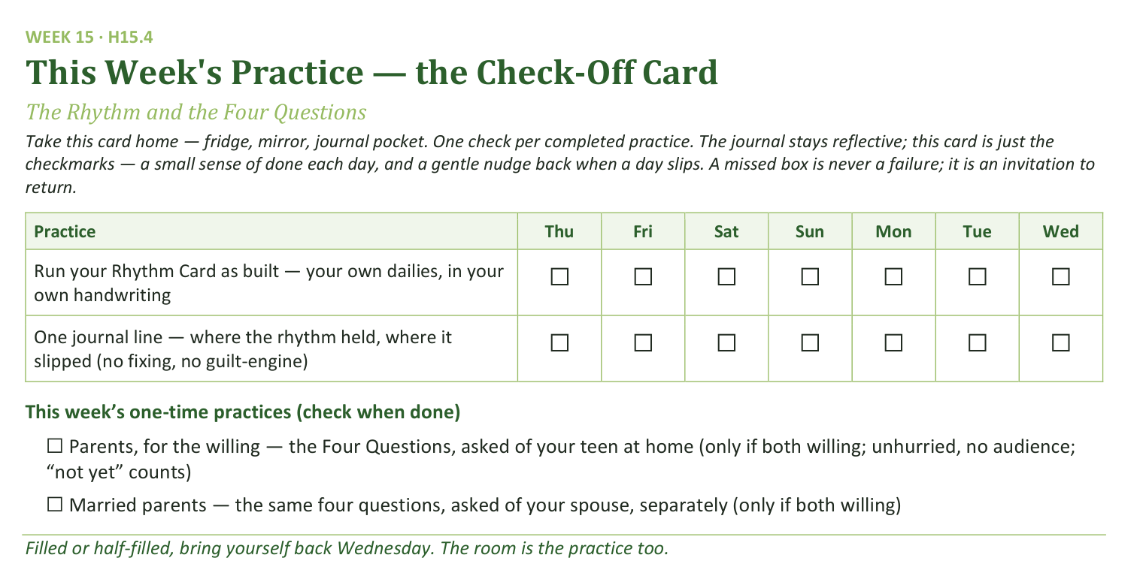
Your Take-Home Card — This Session’s Practice
Handed out now — fridge, mirror, journal pocket.
197
Notes:
S15 · 8:28–8:30 · LEAD: CONTAINER HOLDER
BEATS: 1. The check card rows: your own Rhythm Card dailies, plus one journal line on holds and slips. 2. The one-time boxes are willing-only: the four questions asked of your teen, and separately of your spouse — only if both willing; 'not yet' counts. 3. A missed box is never failure — an invitation to return; come back evenings either way.

